Slide 1
Targeting Dispositions
by Risk, Need, Responsivity
Douglas B. Marlowe, J.D., Ph.D.
National Association of Drug Court Professionals
Modeling If / Then Decisions

Slide 2
Dispositional Continuum
Long-term functioning of the individual
Short-term risk of recidivism
Short-term cost to taxpayers
Treatment
Courts
Decriminalization
De-felonization
Pre-plea diversion
Post-plea diversion
Sentence to probation or community supervision
Sentence to restrictive intermediate punishment (IP / RIP)
Sentence to incarceration

Slide 3
Dispositional Continuum
Long-term functioning of the individual
<------------ FRONT-END DIVERSION ---
------ BACK-END REENTRY--------->
Improved functioning of the individual
Short-term risk of recidivism
Short-term cost to taxpayers
Short-term risk of recidivism
Short-term cost to taxpayers
Treatment
Courts
Decriminalization
De-felonization
Pre--plea
diversion
Post-plea
diversion
Probation or
community supervision
Restrictive
intermediate
Punishment
(IP/ RIP)
Sentence to Incarceration
Conditional release
(parole, probation or community corrections)
Unconditional
release

Slide 4
Offense vs. Offender Decisions
Determinate vs. indeterminate sentencing (vs. guided discretion)
Evidence-based practices (EBPs)
Risk-Needs-Responsivity (RNR)
Graduated sanctions
Positive reinforcement
Collateral consequences (negative reinforcement)

Slide 5
Risk Principle
Not necessarily a risk for violence or dangerousness
Serious prognosis or lesser amenability to treatment
The higher the risk level, the more intensive the supervision and accountability should be; and vice versa
Mixing risk levels is contraindicated!

Slide 6
Prognostic Risk Factors
Current age < 25 years
Delinquent onset < 16 years
Substance abuse onset < 14 years
Prior convictions or incarceration
Prior rehabilitation failure
History of violence
Antisocial Personality Disorder / Psychopathy
Familial history of crime or addiction
Criminal or substance abuse associations

Slide 7
Need Principle
Clinical syndromes or impairments (diagnosis)
The higher the need level, the more intensive the treatment or rehabilitation services should be; and vice versa
Mixing need levels is contraindicated!

Slide 8
Specific Responsivity
Order and timing of intervention is critical:
Responsivity needs: interfere with rehabilitation (e.g., deficient housing, mental illness, withdrawal, anhedonia)
Criminogenic needs: cause or exacerbate crime (e.g., addiction, criminal thinking)
Maintenance needs: degrade rehabilitation gains (e.g., poor education or employment skills)
Humanitarian needs: cause distress (e.g., medical or dental illness)

Slide 9
Risk & Needs Matrix
High Risk
Low Risk
Supervision
Treatment
Pro-social habilitation
Adaptive habilitation
Treatment
(Pro-social habilitation)
Adaptive habilitation
High
Needs
Supervision
Pro-social habilitation
(Adaptive habilitation)
Low
Needs
Secondary prevention
Diversion

Slide 10
Stage in System
Legal standards differ
Defense or prosecution agreement
Available time for treatment and supervision
Differences in base rates for risk and need
Impacts risk or need level (e.g., reentry)
**** Need to get 3-dimensional ****

Slide 11
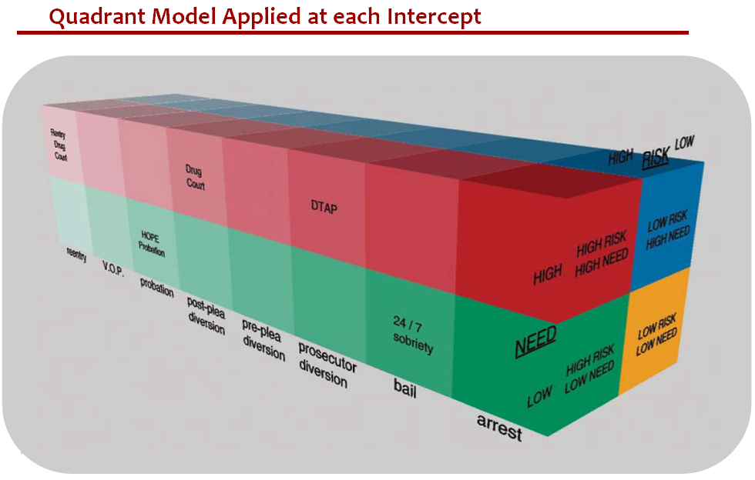
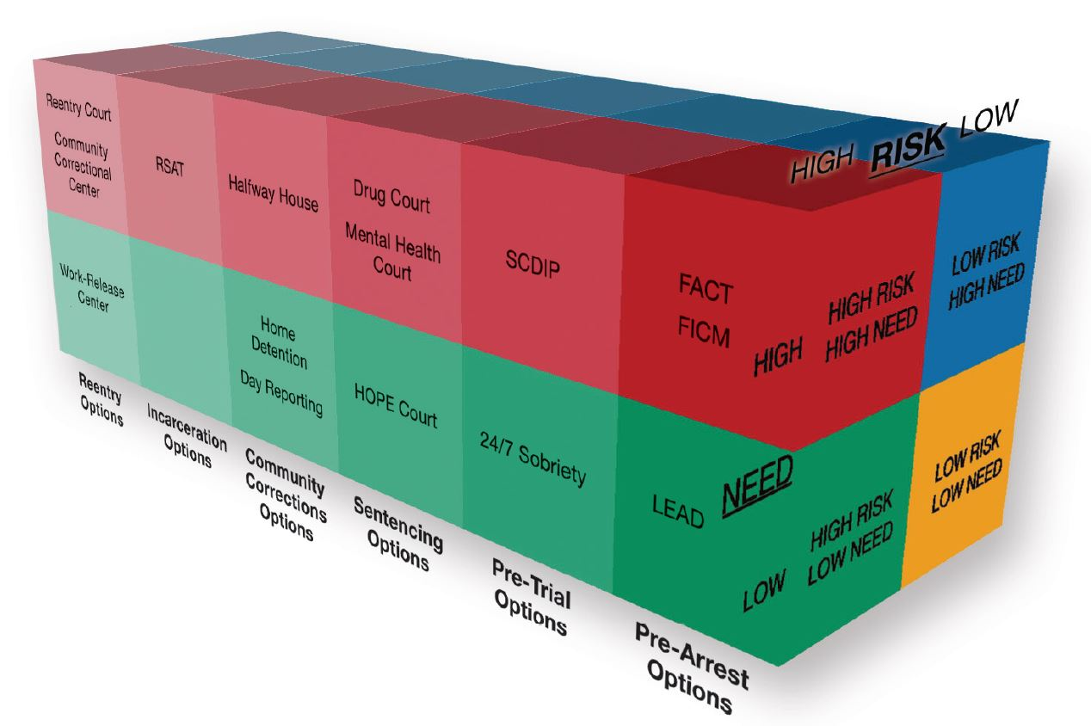

Slide 12
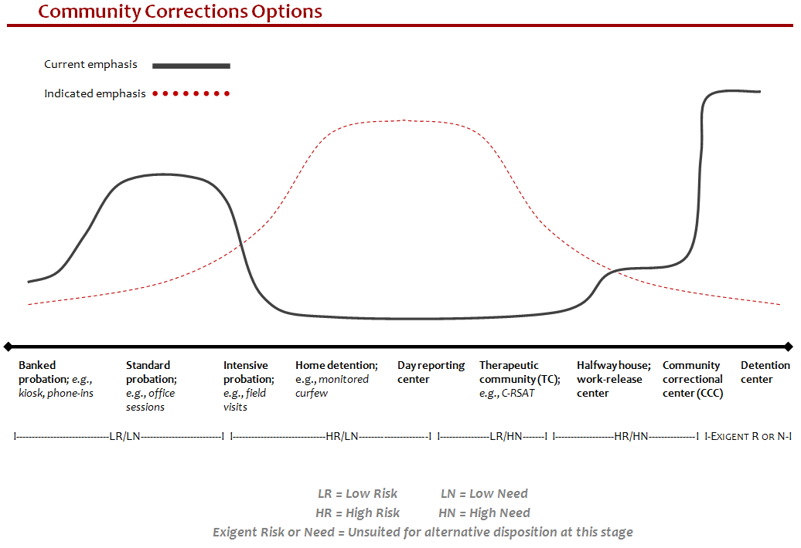
Court-monitored
probation; e.g., HOPE Court
Treatment court;
e.g., Drug Court, MH Court
RIP

Slide 13
Pre-Disposition Assessment
Use immunity, especially at pre-adjudication stage
Require assessment of risk and need after adjudication but prior to disposition (e.g., as part of a PSI)
Valid, reliable & culturally unbiased instruments
Substance abuse vs. dependence diagnosis guides treatment conditions and response to technical violations involving new drug use

Slide 14
Guided Discretion
Require professionals to consider risk and need (excluding certain offenses)
Require professionals to consider effectiveness and cost-effectiveness (excluding certain offenses)
Publish data on recidivism and costs of alternative dispositions
Include dispositional rationale on the record
Restrictive basis for appeal (abuse of discretion)
Publish data on dispositional decisions

Slide 15

Validated Risk Tools
Level of Service Inventory-Revised (LSI-R)
https://ecom.mhs.com/(S(zhkd5d55qlwc3lr2gzqq5w55))/product.aspx?gr=saf&prod=lsi-r&id=overview
Wisconsin Risk and Need Assessment Scale (WRN)
http://j-sat.com/Toolkit/Adult/adf6e846-f4dc-4b1e-b7b1-2ff28551ce85
Risk and Needs Triage (RANT)
http://www.trirant.org/
Correctional Offender Management Profiling for Alternative Sanctions (COMPAS)
http://www.northpointeinc.com/software-suite.aspx
Ohio Risk Assessment System (ORAS)
http://www.uscourts.gov/uscourts/FederalCourts/PPS/Fedprob/2010-06/02_creation_validation_of_oras.html
Federal Post Conviction Risk Assessment (PCRA)
http://www.uscourts.gov/FederalCourts/ProbationPretrialServices/Supervision/PCRA.aspx
Risk Prediction Index (RPI)
http://www.fjc.gov/public/pdf.nsf/lookup/0013.pdf/$file/0013.pdf

Slide 16
Validated Needs Tools
Addiction Severity Index (ASI)
http://www.tresearch.org/wp-content/uploads/2012/09/ASI_5th_Ed.pdf
Global Appraisal of Individual Needs (GAIN)
http://www.gaincc.org/products-services/instruments-reports/
Offender Profile Index (OPI)
https://www.ncjrs.gov/pdffiles1/Digitization/148829NCJRS.pdf
Level of Service/Case Management Inventory (LS/CMI)
https://ecom.mhs.com/(S(0aqkan55ovozwq55w2oxt445))/saf_om.aspx?id=Training
Correctional Offender Management Profiling for Alternative Sanctions (COMPAS)
http://www.northpointeinc.com/software-suite.aspx
Offender Screening Tool (OST)
http://www.azcourts.gov/apsd/EvidenceBasedPractice/RiskNeedsAssessment/OffenderScreeningTool%28OST%29.aspx
Inventory of Offender Risk, Needs, and Strengths (IORNS)
http://www4.parinc.com/Products/Product.aspx?ProductID=IORNS

Slide 17
Validated Diagnostic Tools
Global Appraisal of Individual Needs (GAIN)
http://www.chestnut.org/LI/gain/index.html#Instruments
Structured Clinical Interview for the DSM-IV (SCID)
http://www.scid4.org/
Psychiatric Research Interview for Substance and Mental Disorders (PRISM)
http://www.columbia.edu/~dsh2/prism/
Diagnostic Interview Schedule (DIS)
http://www.enotes.com/drugs-alcohol-encyclopedia/diagnostic-interview-schedule-dis
Texas Christian University (TCU) Drug Dependence Screen-II
http://www.ibr.tcu.edu/pubs/datacoll/Forms/ddscreen-95.pdf

